Slide 1
Important Python Libraries For Data Analysis

Slide 2
NLTK (Natural Language Toolkit)
The NLTK module is a massive tool kit, aimed at helping us with the entire Natural Language Processing (NLP) methodology.
It is primarily used for Natural Language processing and semantic analysis of text.
Few of the many features of NLTK:
Splitting sentences from paragraphs
Splitting up words
Recognizing the part of speech
Highlighting the main subjects
In general, it helps our machine to understand what the text is all about.
Free Book on NLTK: http://www.nltk.org/book/
Documentation: http://www.nltk.org/py-modindex.html

Slide 3
NLTK Install instructions
Open terminal / cmd and type: pip install nltk
Open python console and type:
import nltk
nltk.download()
Select all-nltk and download.
from nltk.corpus import stopwords
data = "All work and no play makes jack a dull boy, all work and no play“
print(word_tokenize(data))

Slide 4
A short Intro
Data processing takes time! Even for a human, NLP is a difficult task! Therefore, to increase efficiency, speed and also decrease noise, we use nltk to extract useful data and ignore all unwanted data.
nltk provides us with numerous classes and functions to make this process much easier!

Slide 5
Tokenizing
Split the following short (and random) paragraph into sentences and words:
Hello Mr. Smith, how are you doing today? The weather is great, and Python is awesome. The sky is pinkish-blue. You shouldn't eat cardboard! I am so blue I'm greener than purple. I stepped on a Corn Flake, now I'm a Cereal Killer. Everyday a grape licks a friendly cow. Look, a distraction! If your canoe is stuck in a tree with the headlights on, how many pancakes does it take to get to the moon?
EXAMPLE_TEXT.split()
from nltk.tokenize import sent_tokenize, word_tokenize
sent_tokenize(EXAMPLE_TEXT)
word_tokenize(EXAMPLE_TEXT)

Slide 6
Stop words
from nltk.corpus import stopwords
print(set(stopwords.words('english')))
Use this on the previous paragraph to extract all the words except the stop words.

Slide 7
Stemming
The idea of stemming is a sort of normalizing method. Many variations of words carry the same meaning, other than when tense is involved.
The reason why we stem is to shorten the lookup, and normalize sentences.
from nltk.stem import PorterStemmer
ps = PorterStemmer()
print(ps.stem(w))
Use stemming on this sample text:
"It is important to by very pythonly while you are pythoning with python. All pythoners have pythoned poorly at least once."

Slide 8
PyData
PyData is a community for all things related to the use of Python in data management and analysis. It provides us with numerous Python libraries related to data analysis.
Several important python packages and software are a part of their contribution:
Scikit-Learn
SciPy
Anaconda
Scikit-Image
Numba
PyData libraries download page:
https://pydata.org/downloads.html
More info: https://pydata.org/

Slide 9
Scikit-Learn
Scikit-learn provides a range of supervised and unsupervised learning algorithms via a consistent interface in Python.
The library is focused on modeling data. It is not focused on loading, manipulating and summarizing data. For these features, refer to NumPy and Pandas.
Some popular groups of models provided by scikit-learn include:
Clustering: for grouping unlabeled data such as KMeans.
Cross Validation: for estimating the performance of supervised models on unseen data.
Datasets: for test datasets and for generating datasets with specific properties for investigating model behavior.
Dimensionality Reduction: for reducing the number of attributes in data for summarization, visualization and feature selection such as Principal component analysis.

Slide 10
5. Ensemble methods: for combining the predictions of multiple supervised models.
6. Feature extraction: for defining attributes in image and text data.
7. Feature selection: for identifying meaningful attributes from which to create supervised models.
8. Parameter Tuning: for getting the most out of supervised models.
9. Manifold Learning: For summarizing and depicting complex multi-dimensional data.
10. Supervised Models: a vast array not limited to generalized linear models, discriminate analysis, naive bayes, lazy methods, neural networks, support vector machines and decision trees.
DOCUMENTATION:
http://scikit-learn.org/stable/documentation.html

Slide 11
SciPy
SciPy is open-source software for mathematics, science, and engineering. The SciPy library depends on NumPy, which provides convenient and fast N-dimensional array manipulation.
SciPy contains modules for optimization, linear algebra, integration, interpolation, special functions, FFT, signal and image processing, ODE solvers and other tasks common in science and engineering.
NumPy and SciPy are easy to use, but powerful enough to be depended upon by some of the world’s leading scientists and engineers.
Several important data analysis libraries are a part of SciPy:
Numpy
Matplotlib
IPython
SymPy
Pandas
Documentation: https://www.scipy.org/docs.html

Slide 12
NumPy
NumPy is the fundamental package for scientific computing with Python. It contains among other things:
a powerful N-dimensional array object
sophisticated (broadcasting) functions
tools for integrating C/C++ and Fortran code
useful linear algebra, Fourier transform, and random number capabilities
Besides its obvious scientific uses, NumPy can also be used as an efficient multi-dimensional container of generic data. Arbitrary data-types can be defined. This allows NumPy to seamlessly and speedily integrate with a wide variety of databases.

Slide 13
Why NumPy?
NumPy functions execute much faster compared to conventional methods and the library consists of several indispensable functions not only related to numerical data analysis but also other domains such as Image processing and any other domain that may need calculations on multi-dimensional matrices.
NumPy comes as a part of the SciPy package(discussed later).

Slide 14
Some Basic NumPy functions
np.zeros(10, dtype = 'uint8'), np.ones – Creates a np array of zeroes and ones
np.arange(10,50) - creates a numpy array in the given range (excluding 50)
np.arange(9).reshape(3,3) – reshapes a given array/matrix
np.nonzero([1,2,0,0,4,0]) – gives indices of non-zero elements
np.eye(3) – Creates an identity matrix of the given shape
np.random.random((3,3,3)) – creates a matrix of random numbers (0,1) of the given shape.
np.nan – A datatype, ‘Not A Numeric’
Z.flags.writeable = False - make an array immutable/writable
Z.astype(np.float32, copy=False) – convert a given array into a different datatype

Slide 15
Documentation and examples
NumPy documentation: https://docs.scipy.org/doc/numpy-1.12.0/reference/
Some Examples: http://www.labri.fr/perso/nrougier/teaching/numpy.100/

Slide 16
pandas
pandas is a Python package providing fast, flexible, and expressive data structures designed to make working with “relational” or “labeled” data both easy and intuitive.
pandas is well suited for many different kinds of data:
Tabular data with heterogeneously-typed columns, as in an SQL table or Excel spreadsheet
Ordered and unordered (not necessarily fixed-frequency) time series data.
Arbitrary matrix data (homogeneously typed or heterogeneous) with row and column labels
Any other form of observational / statistical data sets. The data actually need not be labeled at all to be placed into a pandas data structure

Slide 17
Datatypes in Pandas
The two primary data structures of pandas, Series (1-dimensional) and DataFrame (2-dimensional), handle the vast majority of typical use cases in finance, statistics, social science, and many areas of engineering.

Slide 18
Few functions in Pandas
s = pd.Series(data, index=index)
Here, data can be many different things:
a Python dict
an ndarray
a scalar value (like 5)
The passed index is a list of axis labels.
Notes:
s.Index
d = {'a' : 0., 'b' : 1., 'c' : 2.}
pd.Series(d)
pd.Series(d, index=['b', 'c', 'd', 'a'])
pd.Series(5., index=['a', 'b', 'c', 'd', 'e'])

Slide 19
2. pd.DataFrame (data=None, index=None, columns=None, dtype=None)
Dict can contain Series, arrays, constants, or list-like objects
Index to use for resulting frame. Will default to np.arange(n) if no indexing information part of input data and no index provided
Column labels to use for resulting frame. Will default to np.arange(n) if no column labels are provided
Data type to force, otherwise infer
Notes:
d = {'col1': ts1, 'col2': ts2}
df = DataFrame(data=d, index=index)

Slide 20
3. p.read_csv(filepath_or_buffer, names=None, index_col=None, usecols=None)
Takes the path of a csv file as input, returns a dataframe.
filepath - The string could be a URL. Valid URL schemes include http, ftp, s3, and file.
Names - List of column names to use.
index_col - Column to use as the row labels of the DataFrame.
usecols - Return a subset of the columns.

Slide 21
Some Frequently used dataframe methods
df.dropna()
df.iloc[index]
df[‘ColumnName’]
df.replace()
df.mean(), sum()
pd.concat(List_of_df_to_concat, axis)
df.to_csv(path, columns, index=False)

Slide 22
Data download link
https://goo.gl/UGA2MM
https://goo.gl/Joaqui Navigate to the link, click "Raw"

Slide 23
Some basic tutorials and Documentation:
http://pandas.pydata.org/pandas-docs/version/0.15.2/tutorials.html
https://pandas.pydata.org/pandas-docs/stable/basics.html
Practice and Example Problems:
https://github.com/guipsamora/pandas_exercises

Slide 24
post = {"user_id":209, "message":"D5 E5 C5 C4 G4", "language":"English", "location":(44.590533, -104.715556)}
type(post)
print(post)
post["user_id2"] = 210
post["message2"] = "Hello"
print(post)
print(post["message"])
for key, value in post.items():
print(key, "=", value)

Slide 25
from nltk.tokenize import word_tokenize
data = "All work and no play makes jack a dull boy, all work and no play"
print(word_tokenize(data))
import numpy as np
import matplotlib.pyplot as plt
# Compute the x and y coordinates for points on a sine curve
x = np.arange(0, 3 * np.pi, 0.1)
y = np.sin(x)
# Plot the points using matplotlib
plt.plot(x, y)
plt.show() # You must call plt.show() to make graphics appear.

Slide 26
import numpy as np
from scipy.spatial.distance import pdist, squareform
x = np.array([[0, 1], [1, 0], [2, 0]])
print(x)
d = squareform(pdist(x, 'euclidean'))
print(d)
import numpy as np
x = np.array([[1,2],[3,4]])
print(np.sum(x)) # Compute sum of all elements; prints "10"
print(np.sum(x, axis=0)) # Compute sum of each column; prints "[4 6]"
print(np.sum(x, axis=1)) # Compute sum of each row; prints "[3 7]"

Slide 27
import numpy as np
a = np.array([1, 2, 3]) # Create a rank 1 array
print(type(a)) # Prints "<class 'numpy.ndarray'>"
print(a.shape) # Prints "(3,)"
print(a[0], a[1], a[2]) # Prints "1 2 3"
a[0] = 5 # Change an element of the array
print(a) # Prints "[5, 2, 3]"
b = np.array([[1,2,3],[4,5,6]]) # Create a rank 2 array
print(b.shape) # Prints "(2, 3)"
print(b[0, 0], b[0, 1], b[1, 0]) # Prints "1 2 4"

Slide 28
import numpy as np
from scipy.spatial.distance import pdist, squareform
# Create the following array where each row is a point in 2D space:
# [[0 1]
# [1 0]
# [2 0]]
x = np.array([[0, 1], [1, 0], [2, 0]])
print(x)
# Compute the Euclidean distance between all rows of x.
# d[i, j] is the Euclidean distance between x[i, :] and x[j, :],
# and d is the following array:
# [[ 0. 1.41421356 2.23606798]
# [ 1.41421356 0. 1. ]
# [ 2.23606798 1. 0. ]]
d = squareform(pdist(x, 'euclidean'))
print(d)

Slide 29
import numpy as np
import matplotlib.pyplot as plt
# Compute the x and y coordinates for points on sine and cosine curves
x = np.arange(0, 3 * np.pi, 0.1)
y_sin = np.sin(x)
y_cos = np.cos(x)
# Plot the points using matplotlib
plt.plot(x, y_sin)
plt.plot(x, y_cos)
plt.xlabel('x axis label')
plt.ylabel('y axis label')
plt.title('Sine and Cosine')
plt.legend(['Sine', 'Cosine'])
plt.show()

Slide 30
import numpy as np
from scipy.misc import imread, imresize
import matplotlib.pyplot as plt
img = imread('cat.jpg')
img_tinted = img * [1, 0.95, 0.9]
# Show the original image
plt.subplot(1, 2, 1)
plt.imshow(img)
# Show the tinted image
plt.subplot(1, 2, 2)
# A slight gotcha with imshow is that it might give strange results
# if presented with data that is not uint8. To work around this, we
# explicitly cast the image to uint8 before displaying it.
plt.imshow(np.uint8(img_tinted))
plt.show()

Slide 31
from scipy.misc import imread, imsave, imresize
# Read an JPEG image into a numpy array
img = imread('cat.jpg')
print(img.dtype, img.shape) # Prints "uint8 (400, 248, 3)"
# We can tint the image by scaling each of the color channels
# by a different scalar constant. The image has shape (400, 248, 3);
# we multiply it by the array [1, 0.95, 0.9] of shape (3,);
# numpy broadcasting means that this leaves the red channel unchanged,
# and multiplies the green and blue channels by 0.95 and 0.9
# respectively.
img_tinted = img * [1, 0.95, 0.9]
# Resize the tinted image to be 300 by 300 pixels.
img_tinted = imresize(img_tinted, (300, 300))
# Write the tinted image back to disk
imsave('cat_tinted.jpg', img_tinted)

Slide 32
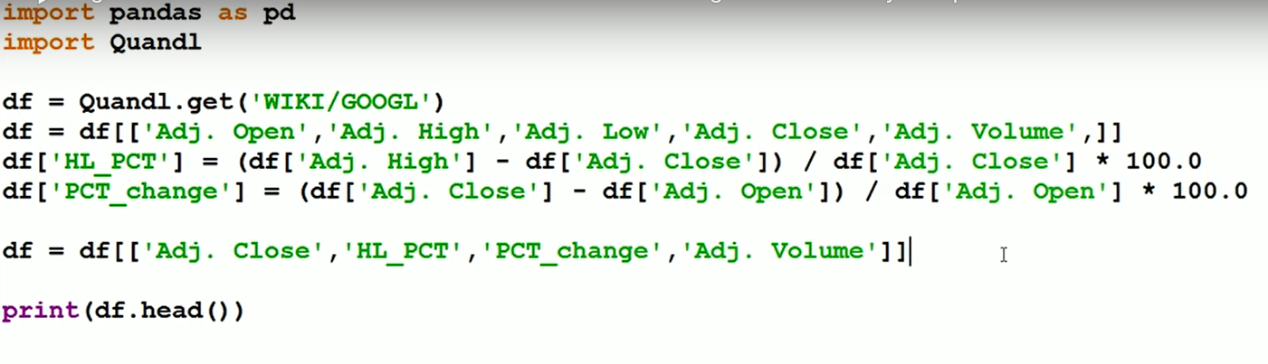

Slide 33
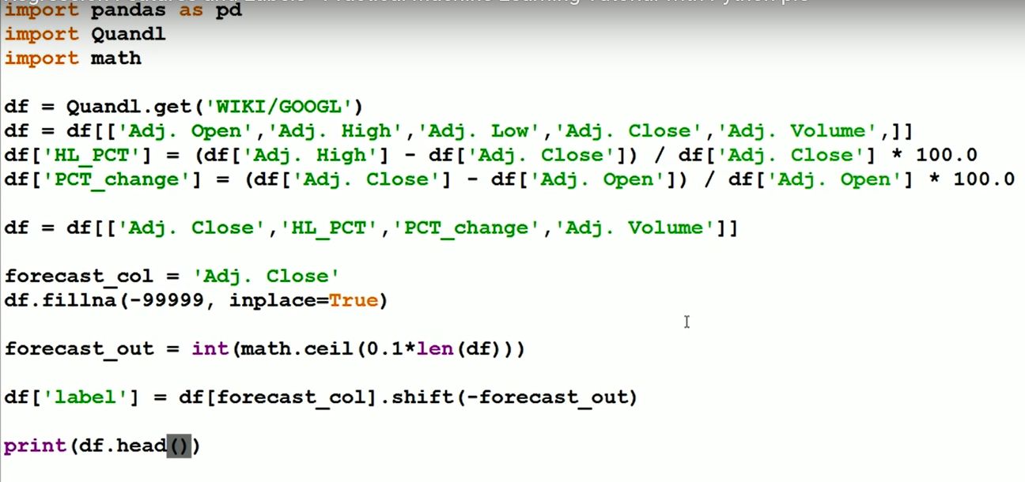

Slide 34
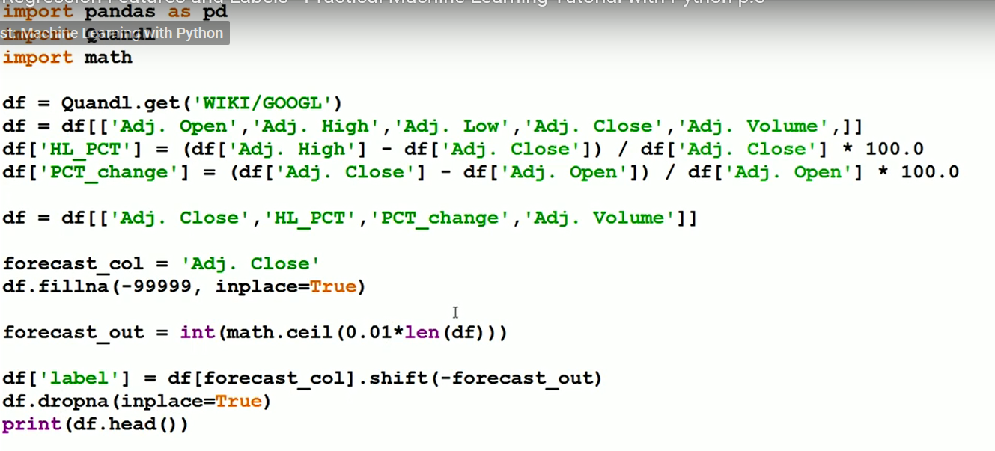

Slide 35
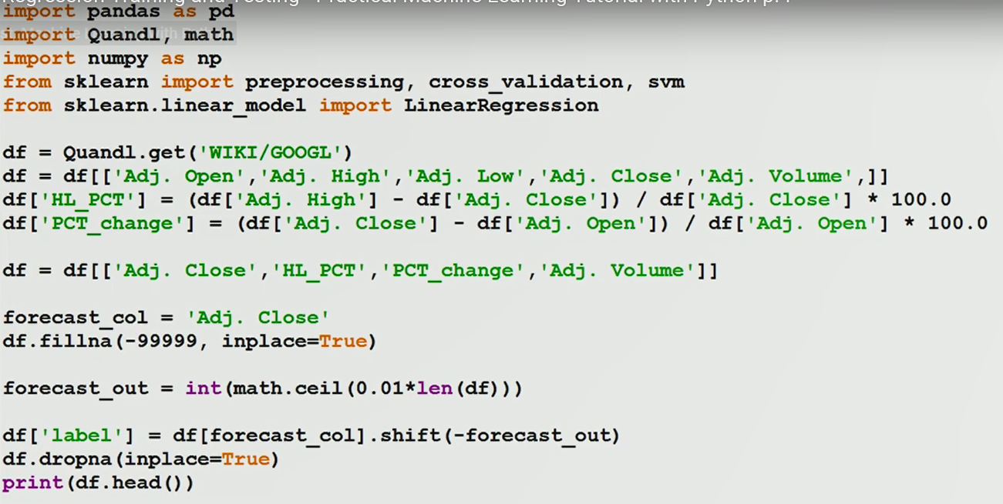

Slide 36
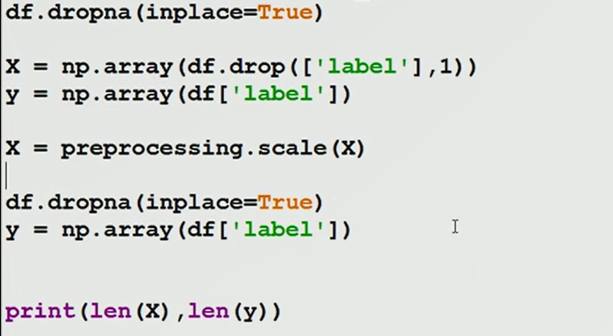

Slide 37
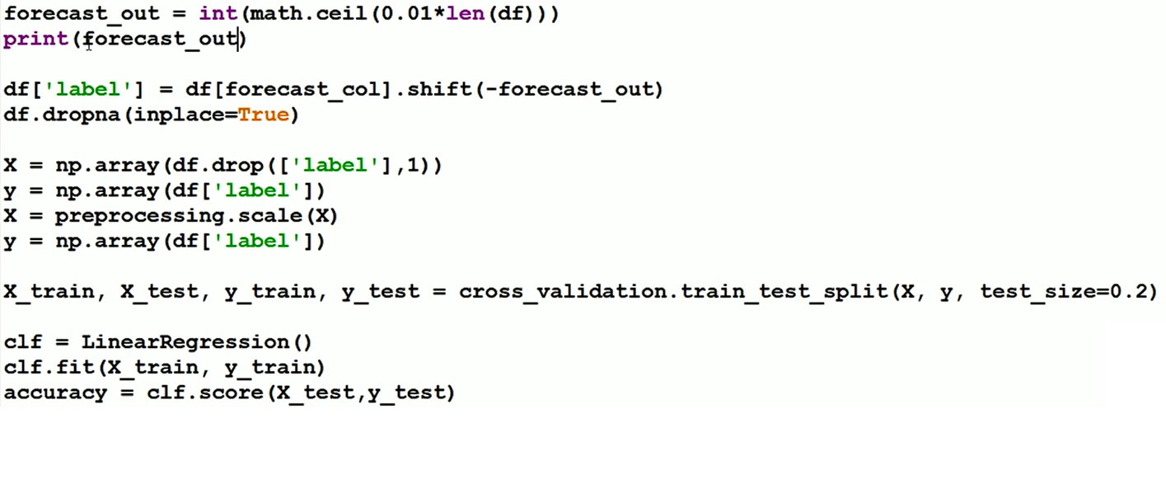

Slide 38
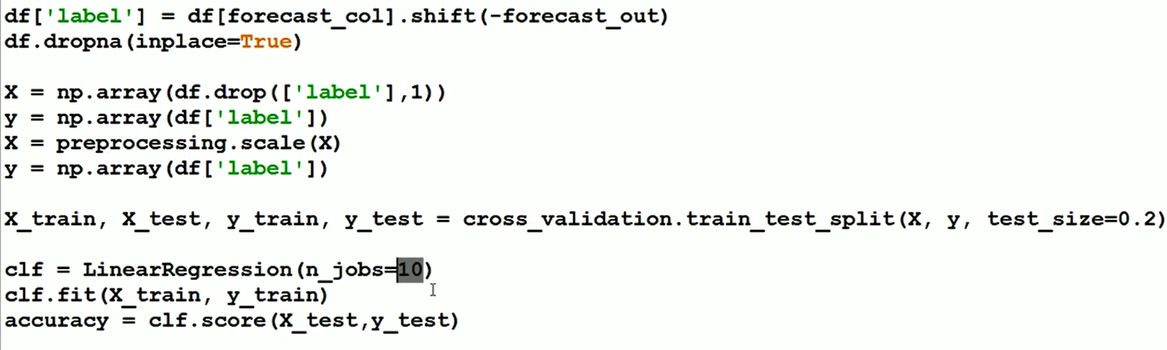

Slide 39
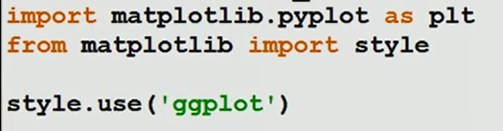
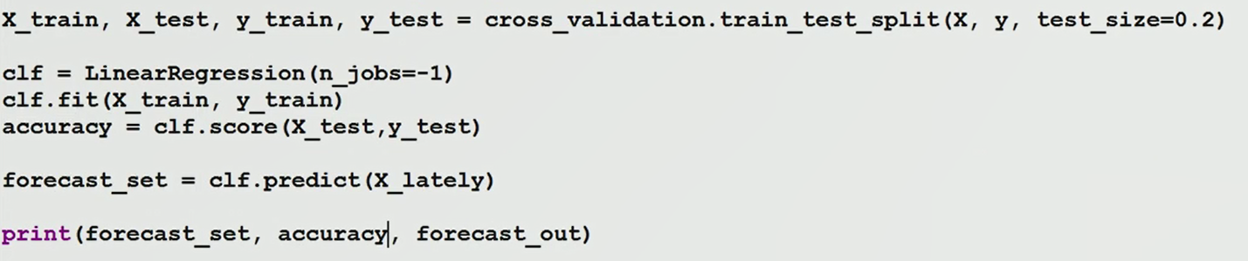

Slide 40
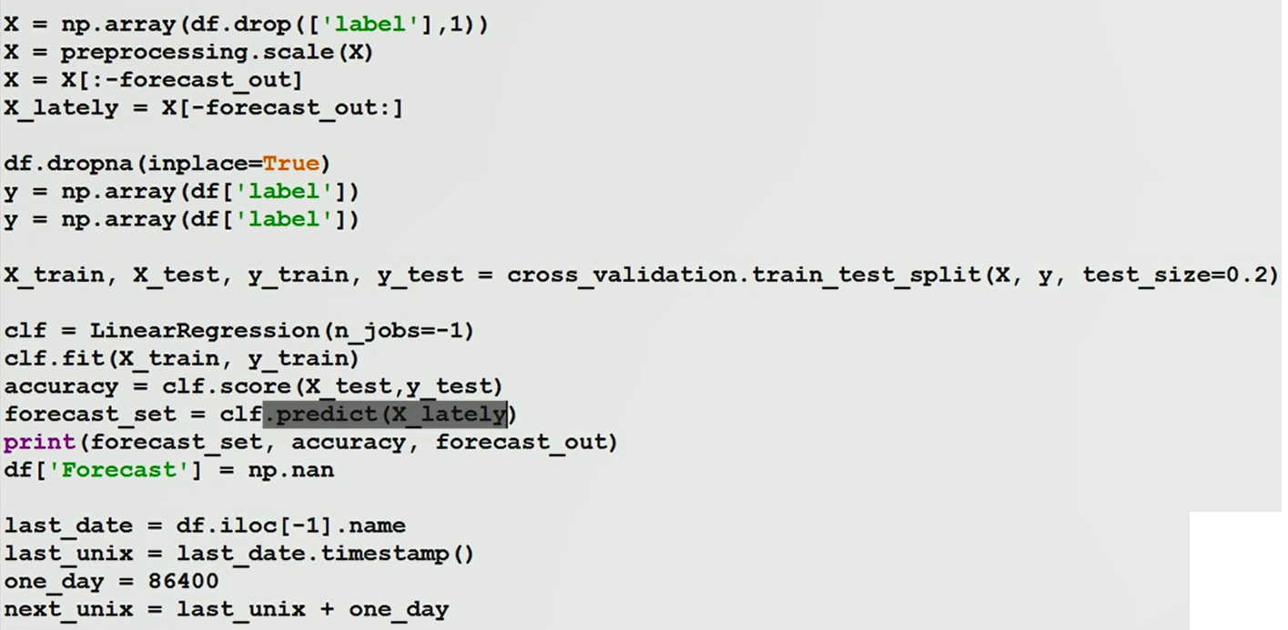

Slide 41
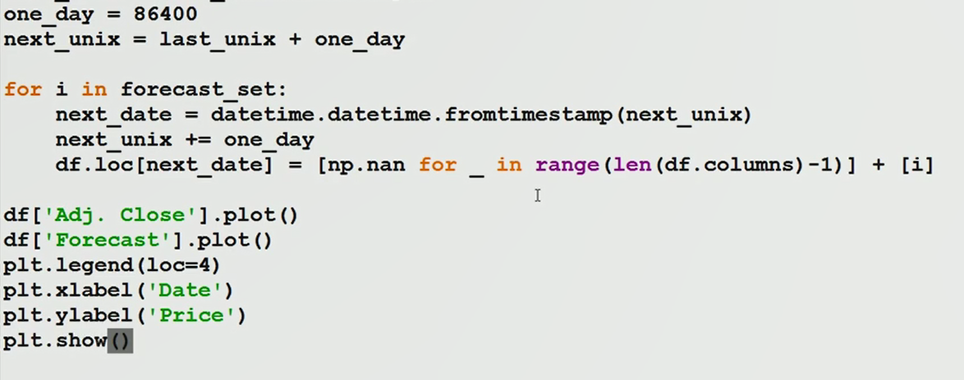

Slide 42
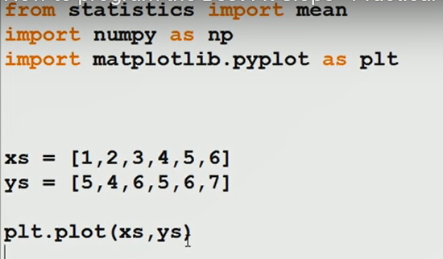

Slide 43
